Slide 1
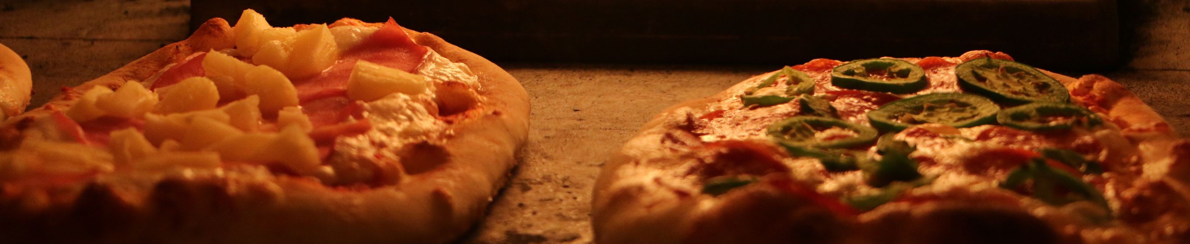
PIZZA SALES
REPORT

Slide 2

HELLO
My name is Priyanka, In this project, I analyzed Pizza Sales Data using MYSQL to uncover key insights.

Slide 3
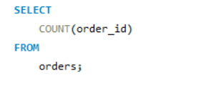
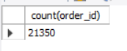
-RETRIEVE THE TOTAL NUMBER OF ORDERS PLACED

Slide 4
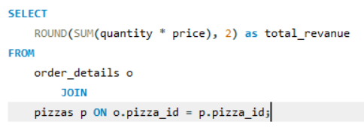
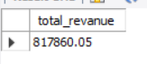
Calculate the total revanue generated from pizza sales.

Slide 5
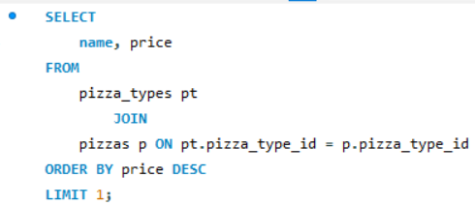
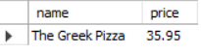
IDENTIFY THE HIGHEST PRICED PIZZA

Slide 6
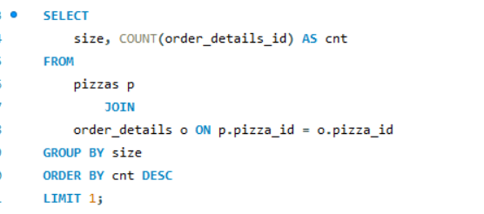
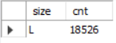
IDENTIFY THE MOST COMMON PIZZA SIZE ORDERED

Slide 7
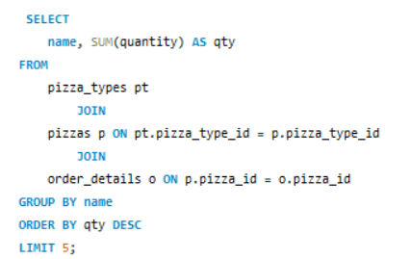
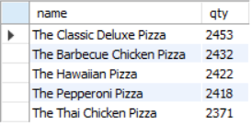
LIST THE TOP 5 MOST ORDERED PIZZA TYPES along with their quantities

Slide 8
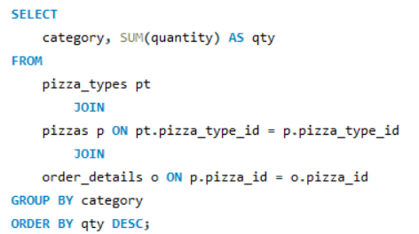
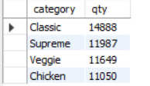
JOIN NECESSAY TABLES TO FIND THE total quantity of each pizza category ordered.

Slide 9
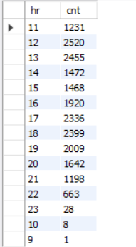
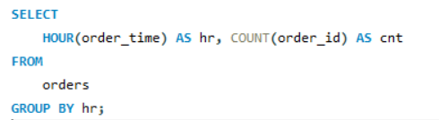
DETERMINE THE DISTRIBUTION OF ORDERS BY HOUR OF THE DAY.

Slide 10
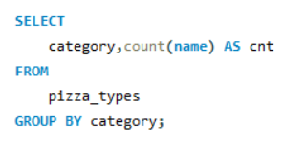
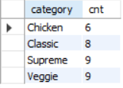
JOIN THE NECESSARY TABLES TO FIND THE category wise distribution of pizzas

Slide 11
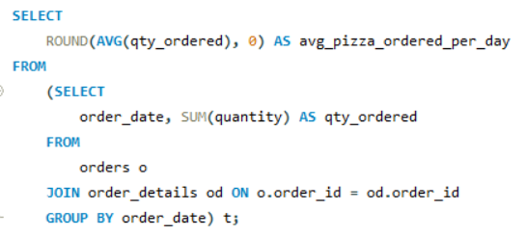
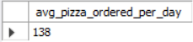
GROUP THE ORDERS BY DATES AND
calculate the average number of pizzas ordered per day.

Slide 12
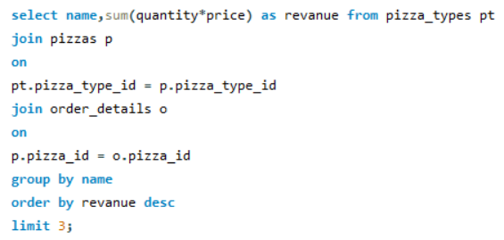
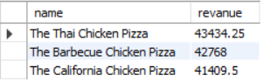
DETERMINE THE TOP 3 MOST ORDERED PIZZA TYPES BASED ON REVANUE.

Slide 13
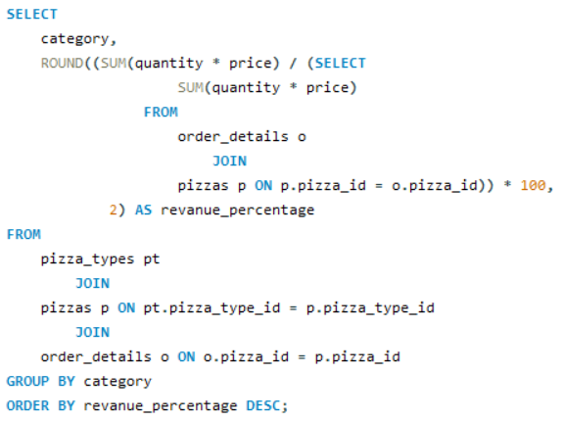
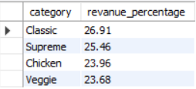
CALCULATE THE PERCENTAGE CONTRIBUTION OF EACH PIZZA TYPE TO TOTAL REVANUE.

Slide 14
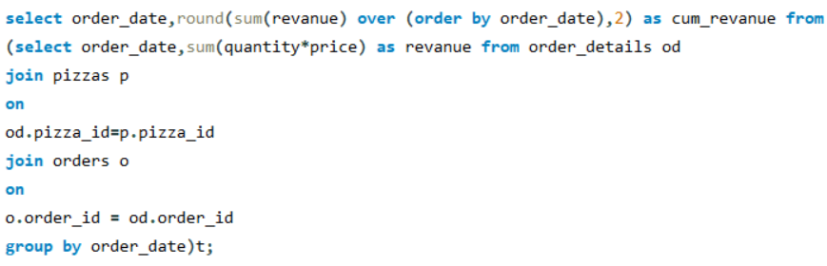
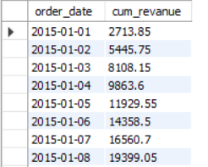
ANALYSE THE CUMMULATIVE REVANUE GENERATED OVER TIME

Slide 15
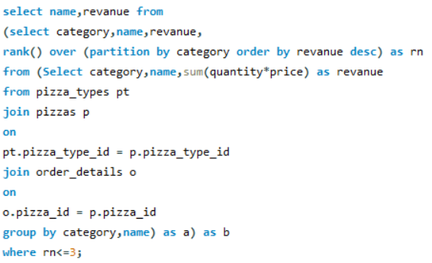
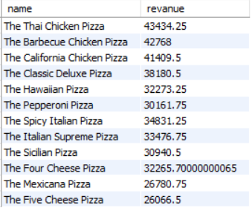
DETERMINE THE TOP 3 MOST ORDERED PIZZAS TYPES based on revanue for each pizza category.

Slide 16
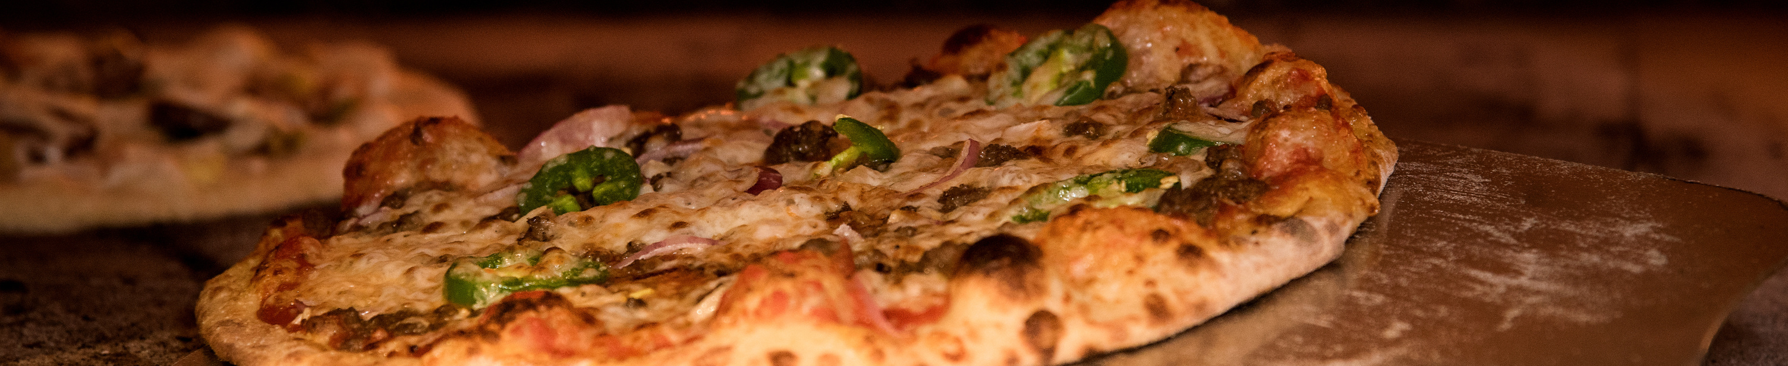
THANK YOU

